Slide 1



Module 7 – Part 1
Ps
Object-Oriented Programming and class Design

Slide 2
Motivation
Object-Oriented Programming (OOP) is based on the concept of classes, from which objects are created.
This requires a new way of thinking, so hold on…

Slide 3
Classes
Using classes, we’re actually creating new data types!
A class represents the concept of things in the real world, like Dogs.
Classes follow a template, and have:
a name
variables (often called “attributes”)
functions (which are now called “methods”, “behaviors” or “member functions”)
8/19/20
CSE 1321 Module 6
3

Slide 4
The Smallest Class
CLASS Dog
BEGIN
END CLASS
// Note: easy points on the exam
Ps

Slide 5
The Smallest Class – C# and Java
class Dog {
}

Slide 6

The Smallest Class - C++
class Dog {
};
// Note: C++ will be different
// in structure. This will become
// our “header” file (later)

Slide 7
Oh no! What have we done?
We’ve:
created a new (complex) data type!
created the “concept” of a Dog
We don’t have any Dogs yet, just the concept

Slide 8
Objects
An object:
is an entity in the real world that can be distinctly identified
might represent a particular dog, employee, student, etc.
has a unique identity, state, and behavior.
8/19/20
CSE 1321 Module 6
8

Slide 9
Object Identity, State and Behavior
An object has a unique identity as it represents one entity.
The object state consists of a set of data fields (instance variables or properties) with their current values.
The object behavior is defined by a set of methods
Example: Class Student that describes individual students, such that each student has a unique ID, has his/her own state (information), and all students share same behavior (methods).
8/19/20
CSE 1321 Module 6
9

Slide 10
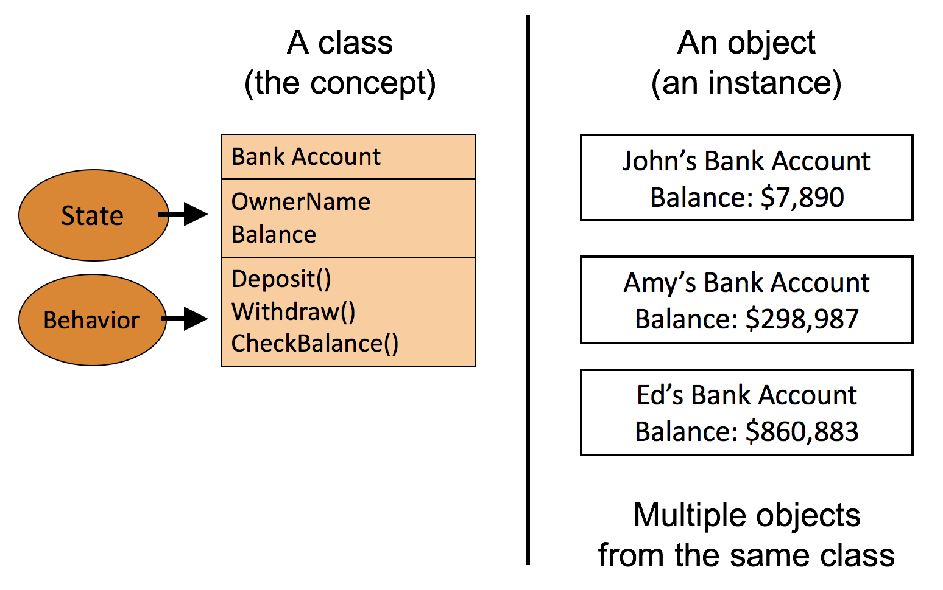
Example: Class Bank Account
8/19/20
CSE 1321 Module 6
10

Slide 11
A “real life” example
Let’s make a Dog!
Attributes (characteristics)
rabid or not rabid (boolean)
weight (a number)
name (string)
Behaviors
growl
eat

Slide 12
Step 1: The Skeleton
CLASS Dog
BEGIN
// attributes will go here – name, weight, rabid
// behaviors will go here – growl, eat
END CLASS
Ps

Slide 13
Step 2: Add attributes
CLASS Dog
BEGIN
CREATE rabid ← false
CREATE weight ← 0.0
CREATE name ← “ ”
// Behaviors go here
END CLASS
Ps

Slide 14
Step 3: The Constructor
This is a special method
Used to give initial values to ALL attributes
Is activated when someone creates a new instance of the class
Doesn’t have a return type
In most languages, the name of this method MUST be the same name as the class

Slide 15
Step 3: Designing the Constructor
Constructors will vary, depending on design
Ask questions:
Are all Dogs born with the same rabid state? (yes – they are all born non-rabid)
Are all Dogs born with the same weight? (no – they are born with different weights)
Are all Dogs born with the same name? (no – they all have different names)
If ever “no”, then you need information passed in as parameters.

Slide 16
Step 3: The Constructor
CLASS Dog BEGIN
CREATE rabid ← false
CREATE weight ← 0.0
CREATE name ← “ ”
// Constructor
CONSTRUCTOR Dog (parameters w, n)
rabid ← false
weight ← w
name ← n
END CONSTRUCTOR
// Behaviors go here
END CLASS
Ps

Slide 17
Step 4: Relax and Take a break
We’ll get to growl and eat later
We have a new data type (Dog)
Let’s play around with the main algorithm

Slide 18
The “Driver”
Usually put this in a whole new file!
The Driver contains main
It’s the controlling algorithm
Steps:
Type in the skeleton
Create a couple of instances of classes
Start telling them what to do

Slide 19
Step 1: Type in the Skeleton
BEGIN MAIN
END MAIN
Ps

Slide 20
Step 2: Declare Two Dogs
BEGIN MAIN
CREATE j1, j2 AS Dog
END MAIN
Memory
null
j1
j2

Slide 21
The new operator
Right now, we have two “dead” dogs
new
Brings instances “to life”
Calls the class’s constructor
Opens up enough space in memory to fit an instance of that class

Slide 22
Step 3: Bring j1 to Life
BEGIN MAIN
CREATE j1, j2 AS Dog
j1 ← new Dog (14, “Bob”)
END MAIN
Memory
null
CONSTRUCTOR Dog (parameters w, n)
rabid ← false
weight ← w
name ← n
END CONSTRUCTOR
j1
j2

Slide 23
Opens Space
BEGIN MAIN
CREATE j1, j2 AS Dog
j1 ← new Dog (14, “Bob”)
END MAIN
Memory
null
CONSTRUCTOR Dog (parameters w, n)
rabid ← false
weight ← w
name ← n
END CONSTRUCTOR
j1
j2

Slide 24
Data Passing
BEGIN MAIN
CREATE j1, j2 AS Dog
j1 ← new Dog (14, “Bob”)
END MAIN
Memory
null
CONSTRUCTOR Dog (parameters w, n)
rabid ← false
weight ← w
name ← n
END CONSTRUCTOR
j1
j2

Slide 25
Data Passing
BEGIN MAIN
CREATE j1, j2 AS Dog
j1 ← new Dog (14, “Bob”)
END MAIN
Memory
null
CONSTRUCTOR Dog (parameters w, n)
rabid ← false
weight ← w
name ← n
END CONSTRUCTOR
j1
j2
rabid:false
weight:14
name:"Bob”

Slide 26
Bring j2 to Life
BEGIN MAIN
CREATE j1, j2 AS Dog
j1 ← new Dog (14, “Bob”)
j2 ← new Dog (7, “Ethel”)
END MAIN
Memory
null
j1
j2
rabid:false
weight:14
name:”Bob”

Slide 27
New calls the Constructor
BEGIN MAIN
CREATE j1, j2 AS Dog
j1 ← new Dog (14, “Bob”)
j2 ← new Dog (7, “Ethel”)
END MAIN
Memory
null
CONSTRUCTOR Dog (parameters w, n)
rabid ← false
weight ← w
name ← n
END CONSTRUCTOR
j1
j2
rabid:false
weight:14
name:”Bob”

Slide 28
Opens Space for j2
BEGIN MAIN
CREATE j1, j2 AS Dog
j1 ← new Dog (14, “Bob”)
j2 ← new Dog (7, “Ethel”)
END MAIN
Memory
null
j1
j2
rabid:false
weight:14
name:”Bob”

Slide 29
Passes Data to the Constructor
BEGIN MAIN
CREATE j1, j2 AS Dog
j1 ← new Dog (14, “Bob”)
j2 ← new Dog (7, “Ethel”)
END MAIN
Memory
null
CONSTRUCTOR Dog (parameters w, n)
rabid ← false
weight ← w
name ← n
END CONSTRUCTOR
j1
j2
rabid:false
weight:14
name:”Bob”

Slide 30
Passes Data to the Constructor
BEGIN MAIN
CREATE j1, j2 AS Dog
j1 ← new Dog (14, “Bob”)
j2 ← new Dog (7, “Ethel”)
END MAIN
Memory
null
CONSTRUCTOR Dog (parameters w, n)
rabid ← false
weight ← w
name ← n
END CONSTRUCTOR
j1
j2
rabid:false
rabid:false
weight:14
weight:7
name:”Bob”
name:”Ethel”

Slide 31
Adding Eat() and Growl()
CLASS Dog BEGIN
CREATE rabid ← false
CREATE weight ← 0.0
CREATE name ← “ ”
// Constructor
CONSTRUCTOR Dog (parameters w, n)
rabid ← false
weight ← w
name ← n
END CONSTRUCTOR
// WE STILL NEED EAT AND GROWL
END CLASS
Ps

Slide 32
CLASS Dog BEGIN
CREATE rabid ← false
CREATE weight ← 0.0
CREATE name ← “ ”
CONSTRUCTOR Dog (parameters w, n)
rabid ← false
weight ← w
name ← n
END CONSTRUCTOR
METHOD eat (parameters: amountOfFood)
weight ← weight + amountOfFood
PRINT (name + “ weighs” + weight + “ lbs”) END METHOD
METHOD growl (parameters: none) PRINT (name + “ says GRRRRR!”) END METHOD
END CLASS
Ps

Slide 33
The “.” operator
“Dot” operator used to
Get to an instances attributes
Get to an instances methods
Basically get inside the instance
Format:
<instance>.<attribute or method>

Slide 34
Using the “.” operator
BEGIN MAIN
CREATE j1, j2 AS Dog
j1 ← new Dog (14, “Bob”)
j2 ← new Dog (7, “Ethel”)
j1.eat(2) // Bob weighs 16 lbs
j2.growl() // Ethel says GRRRR
j1.name ← “Fluffy” // This is just cruel
j1.eat(4) // Fluffy weighs 20 lbs
j2.eat(-1) // Ethel weighs 6 lbs
END MAIN

Slide 35
What this looks like in real life
Projects get big, so we put code in different files
In Java:
Classes are put into their own file
The name of the file should be the same as the class, with a .java extension
If it’s a public class (later), the file must be named the same
Example: class Dog would be put into a file called “Dog.java”
In C#:
It’s generally the same thing as Java
Put classes in files of the same name – “Dog.cs”
In C++:
Create a header (.h) file – “Dog.h”
Create a body/implementation file = “Dog.cpp”

Slide 36
class Dog {
boolean rabid = false;
float weight = 0.0f;
String name = "";
Dog (float w, String n) {
weight = w;
name = n;
}
void eat (float amountOfFood) {
weight += amountOfFood;
System.out.println (name+" now weighs " + weight+" lbs");
}
void growl() {
System.out.println (name+" says grrrr");
}
}

Slide 37
class Main {
public static void main(String[] args) {
Dog d1 = new Dog(17.4f, "Fluffy");
d1.eat(3);
}
}

Slide 38
public class Dog {
bool rabid = false;
float weight = 0.0f;
string name = "";
public Dog (float w, string n) {
weight = w;
name = n;
}
public void eat (float amountOfFood) {
weight += amountOfFood;
Console.WriteLine (name+" now weighs " + weight+" lbs");
}
public void growl() {
Console.WriteLine (name+" says grrrr");
}
}

Slide 39
class MainClass {
public static void Main (string[] args) {
Dog d1 = new Dog(17.4f, "Fluffy");
d1.eat(2);
}
}

Slide 40
// This is the header file – Dog.h
class Dog {
public:
bool rabid;
float weight;
string name;
// Note: no method body, only semi-colon
Dog(float w, string n);
void eat(float amountOfFood);
void growl();
};

Slide 41
// The implementation file – Dog.cpp
Dog::Dog(float w, string n) {
rabid = false;
weight = w;
name = n;
}
void Dog::eat(float amountOfFood) {
weight += amountOfFood;
cout << name << " now weighs " << weight << " lbs" << endl;
}
void Dog::growl() {
cout << name << " says grrrr" << endl;
}

Slide 42
// The main file – main.cpp
int main() {
Dog d1 (15.8f, "Fluffy");
d1.eat(10.0f);
// Using "pointers"
Dog* d2 = new Dog(27.4f, "Spike");
d2->eat(5);
}

Slide 43
Summary
A class:
has attributes (which are just variables)
has a constructor which is used to initialize attributes
has other methods (like eat and growl)
is a blueprint (template) for creating objects
creates a new data type
An object:
is an instance of a class
has a state (variables) that is independent from others

